Slide 1
Modeling Project Update
Saqib Rizvi

Slide 2
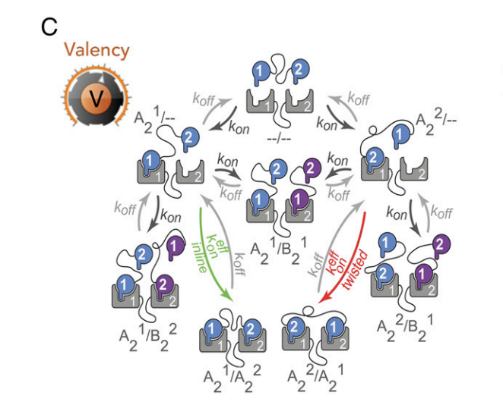
Background
Started off using Casim Sarkar’s work on noncanonical binding dynamics
Three parts:
Affinity (k_{on} and k_{off})
Linkage (L_{eff})
Valency (total no. of microstates)
Errington et al. (2019)
Notes:
Affinity – monovalent rate constants of association and dissociation

Slide 3
Convention
Abbreviations
Polyproline and substrate vector: P-S
SH3 and Kinase vector: H-K
keff is defined for rate constants that differ from the original rate constants due to proximity in our case
k2
k-2
k1
k-1

Slide 4
All possible states
P-S (polyproline-substrate)
H-K (SH3-Kinase)
PH_{K}-S (Polyproline bound to SH3 domain but substrate is free)
P-SK_{H} (Substrate bound to the kinase domain but Polyproline is free)
PH_{K}-SK_{H} (Both the polyproline and substrate domains are bound to an SH3 and kinase domain but the SH3 and kinase domain are from different molecules)
PH=SK (two substrate and kinase vectors are bound together)

Slide 5
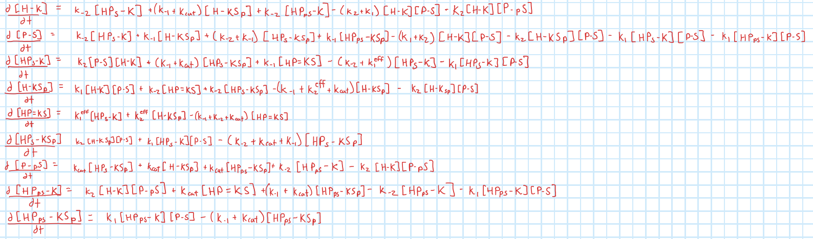
Equations

Slide 6
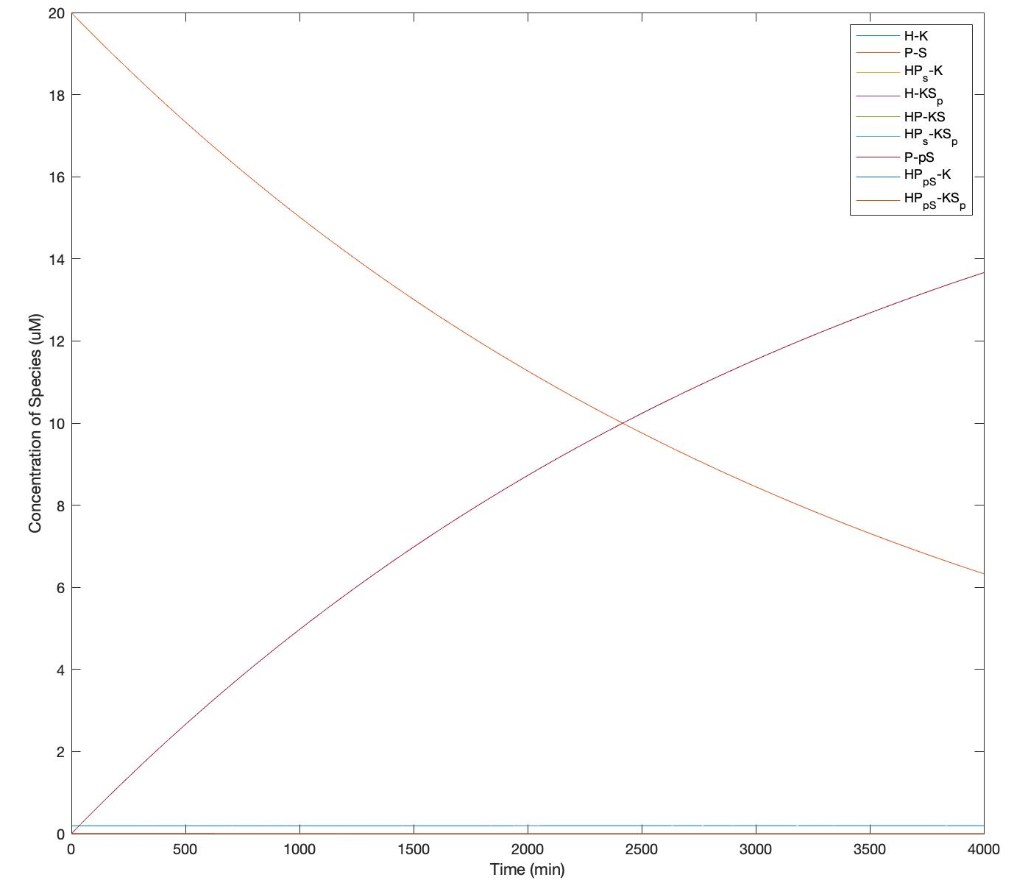
P-pS
P-S

Slide 7
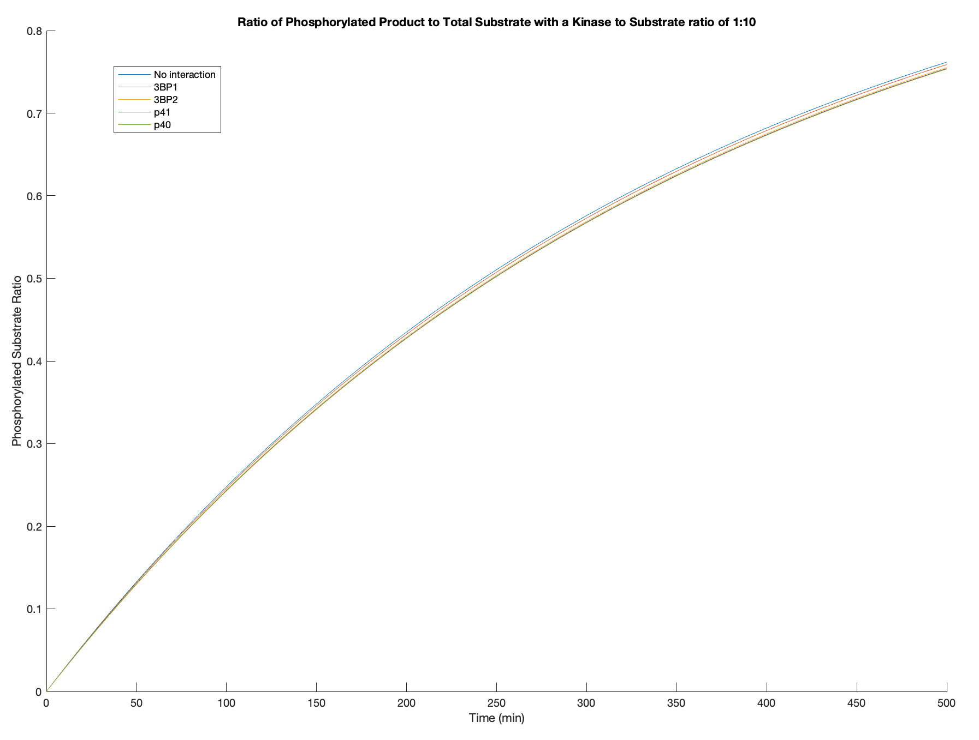
Summary of Results
Same trend is seen in all except for 1:10 where its reversed
My guess is that this is a function of kcat
Trend:
P40>p41>3BP2>3BP1>No Interaction
As kinase to substrate ratio decreases, phosphorylated ratio decreases
At high kinase to substrate ratio, a logarithmic curve is observed
The graphs of the different secondary interactions don’t seem to differ by much

Slide 8
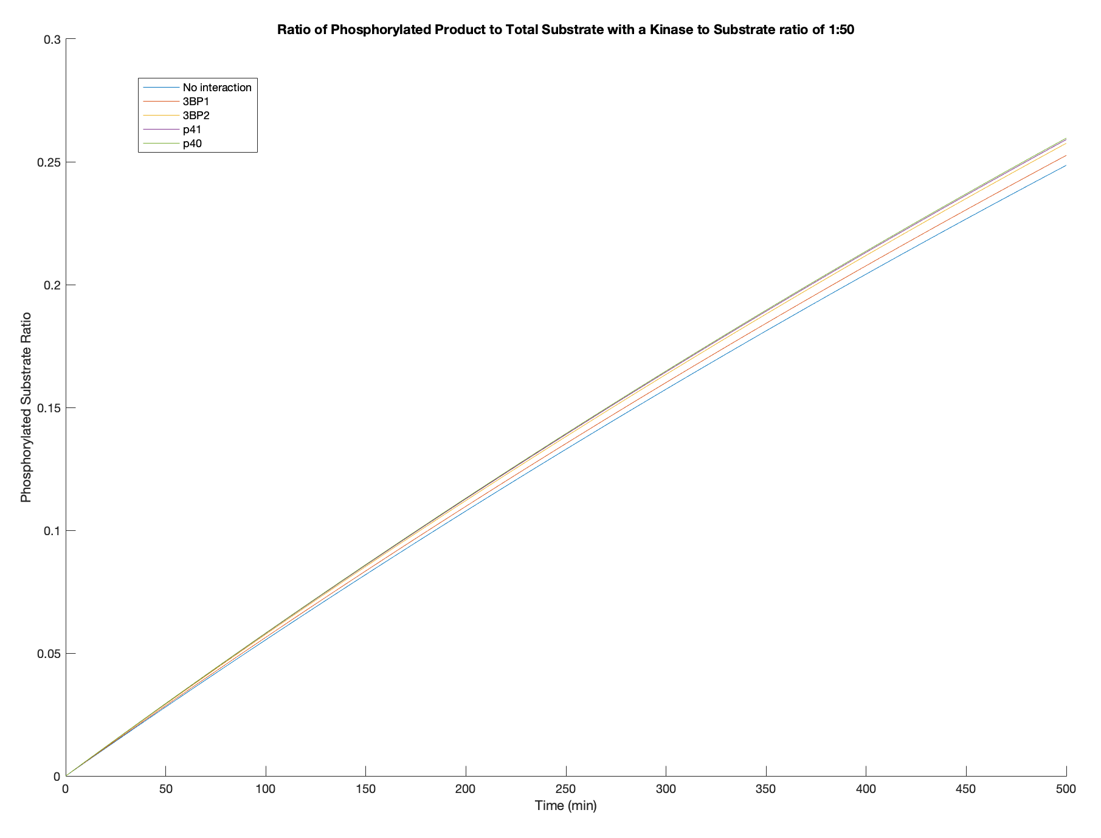
Summary of Results
Same trend is seen in all except for 1:10 where its reversed
My guess is that this is a function of kcat
Trend:
P40>p41>3BP2>3BP1>No Interaction
As kinase to substrate ratio decreases, phosphorylated ratio decreases
At high kinase to substrate ratio, a logarithmic curve is observed
The graphs of the different secondary interactions don’t seem to differ by much

Slide 9
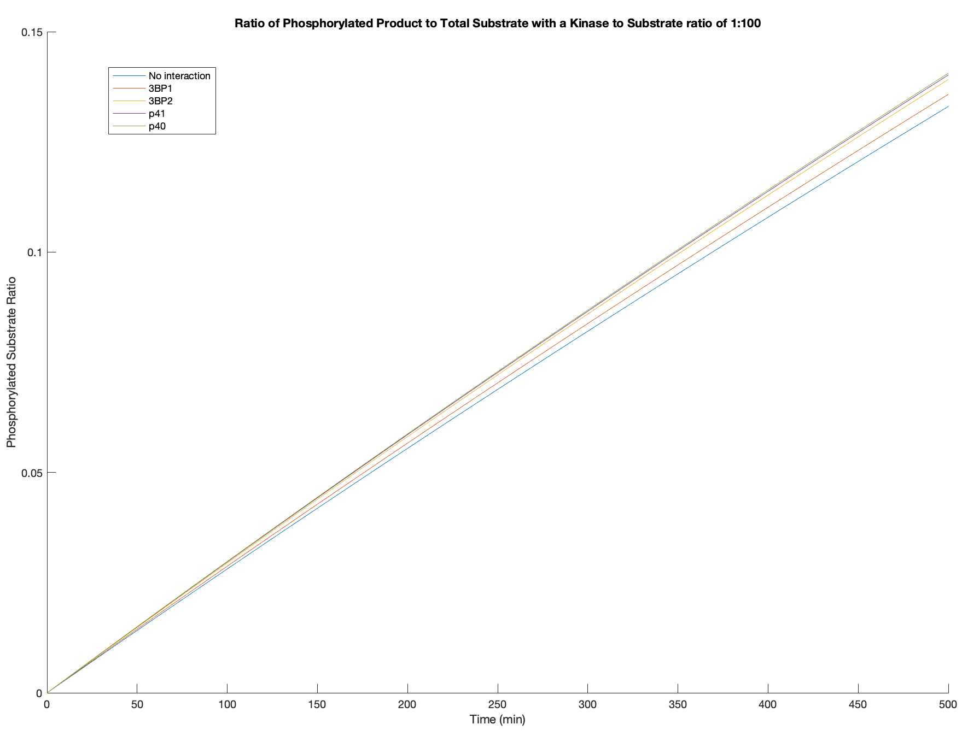
Summary of Results
Same trend is seen in all except for 1:10 where its reversed
My guess is that this is a function of kcat
Trend:
P40>p41>3BP2>3BP1>No Interaction
As kinase to substrate ratio decreases, phosphorylated ratio decreases
At high kinase to substrate ratio, a logarithmic curve is observed
The graphs of the different secondary interactions don’t seem to differ by much

Slide 10
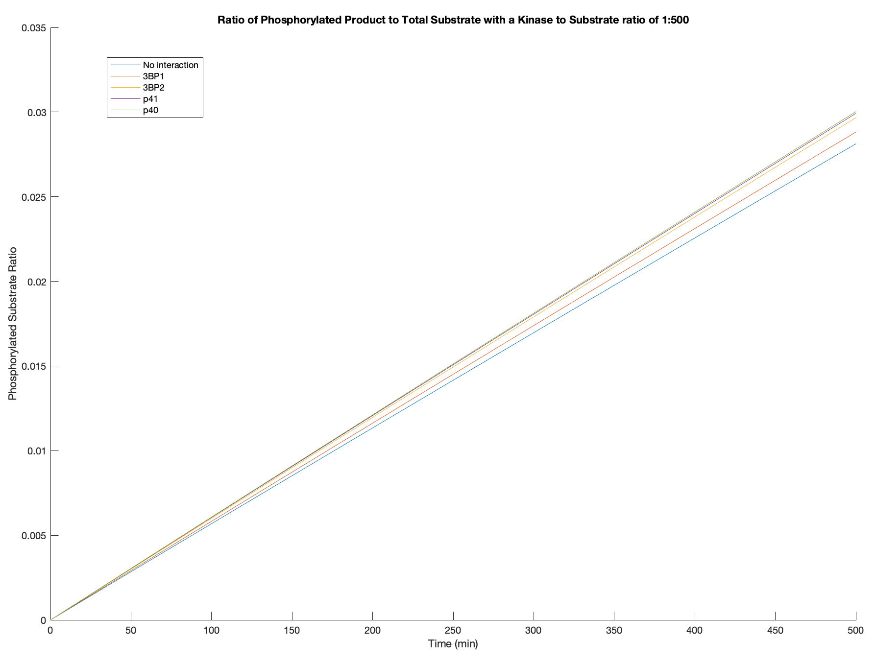
Summary of Results
Same trend is seen in all except for 1:10 where its reversed
My guess is that this is a function of kcat
Trend:
P40>p41>3BP2>3BP1>No Interaction
As kinase to substrate ratio decreases, phosphorylated ratio decreases
At high kinase to substrate ratio, a logarithmic curve is observed
The graphs of the different secondary interactions don’t seem to differ by much

Slide 11
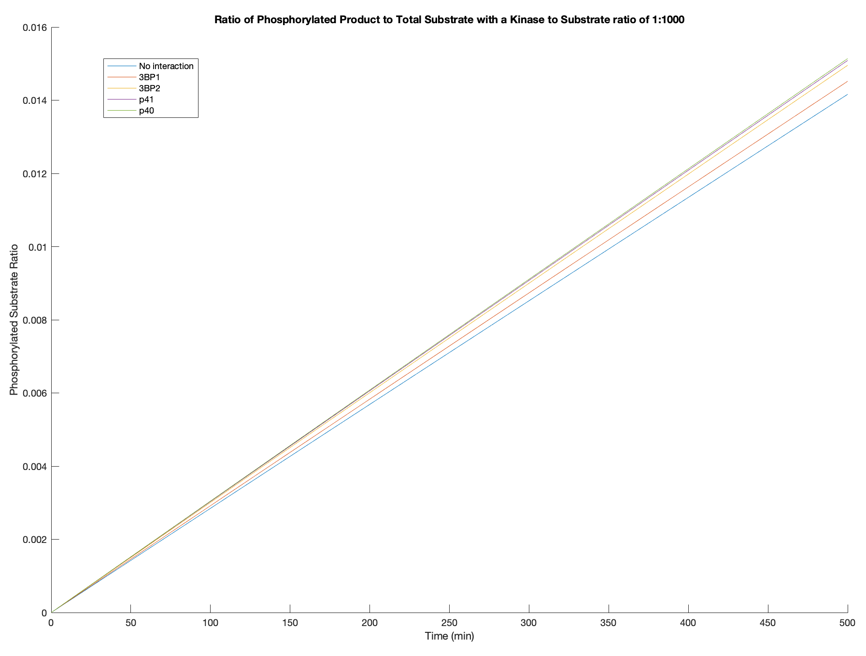
Summary of Results
Same trend is seen in all except for 1:10 where its reversed
My guess is that this is a function of kcat
Trend:
P40>p41>3BP2>3BP1>No Interaction
As kinase to substrate ratio decreases, phosphorylated ratio decreases
At high kinase to substrate ratio, a logarithmic curve is observed
The graphs of the different secondary interactions don’t seem to differ by much

Slide 12
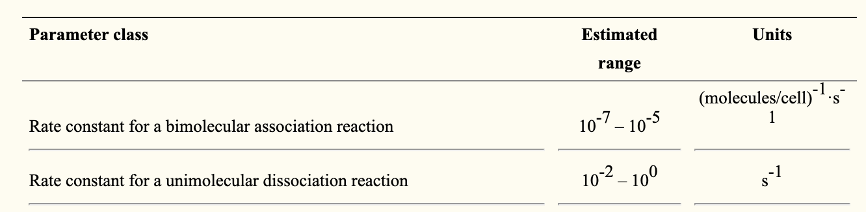
Ranges of values for association and dissociation constants
Creamer et al. (2012)

Slide 13
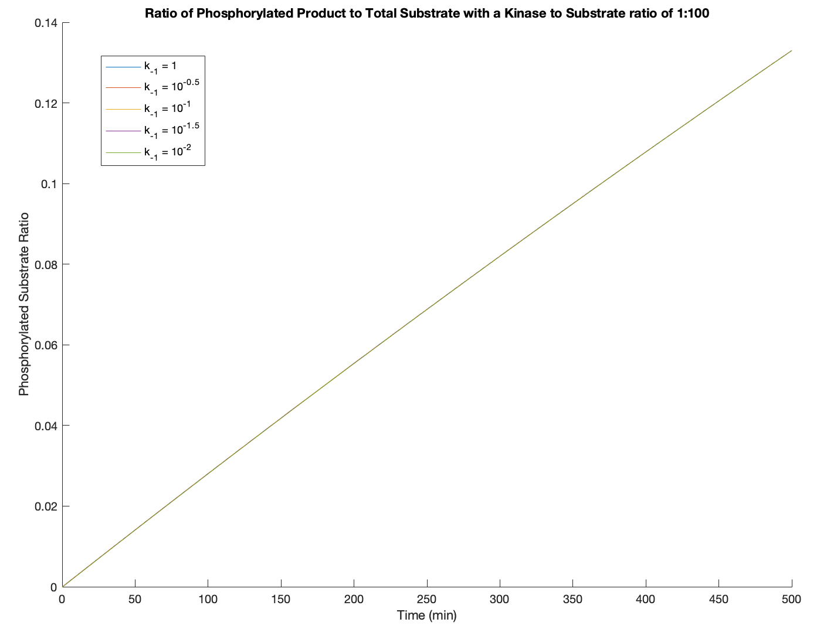
No changes in plot produced when k₋₁ and k₋₂ are changed

Slide 14
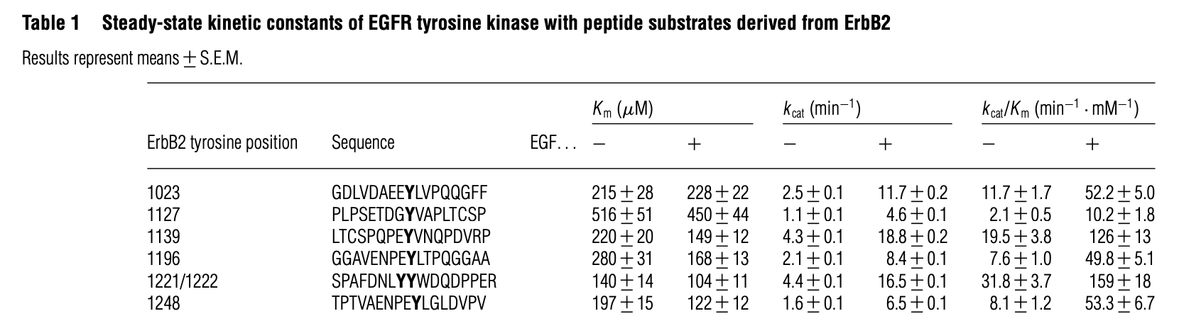
Specificity
Encoded using K_{m} and k_{cat} using the specificity constant
Specificity = k_{cat}/K_{m}
Higher values for specificity → the kinase is more specific
Fan et al. (2005)

Slide 15
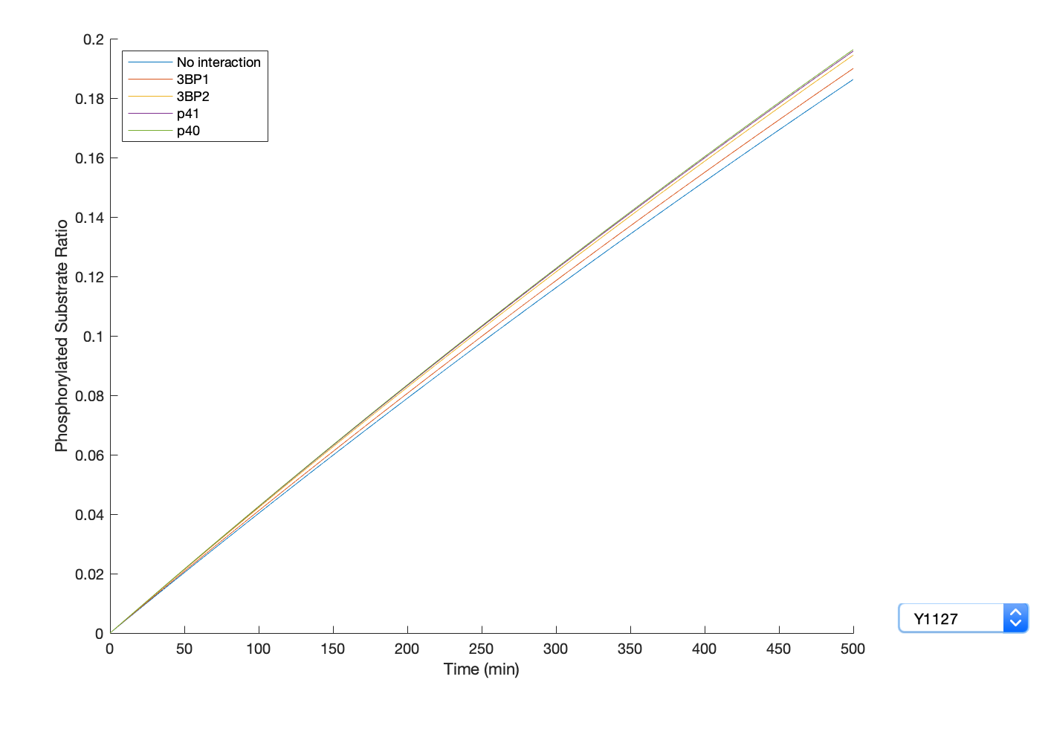
ErbB2 site: Y1127
K_{m} = 516 uM
k_{cat} = 1.1 min⁻¹
k_{cat}/K_{m} = 2.1 min⁻¹mM⁻¹

Slide 16
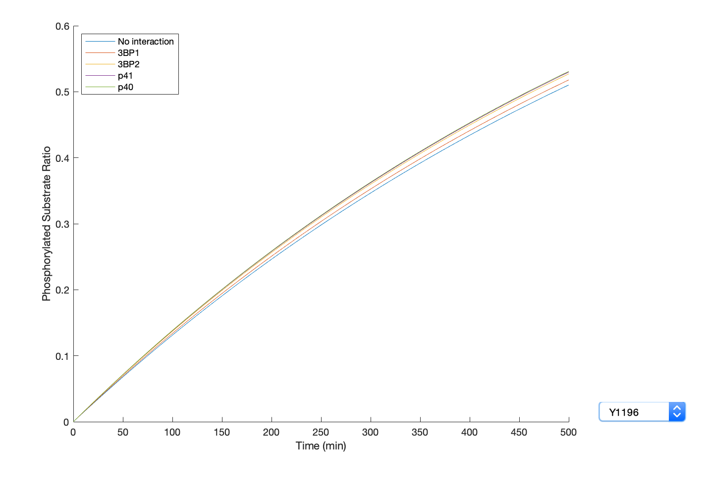
ErbB2 site: Y1196
K_{m} = 280 uM
k_{cat} = 2.1 min⁻¹
k_{cat}/K_{m} = 7.6 min⁻¹mM⁻¹

Slide 17
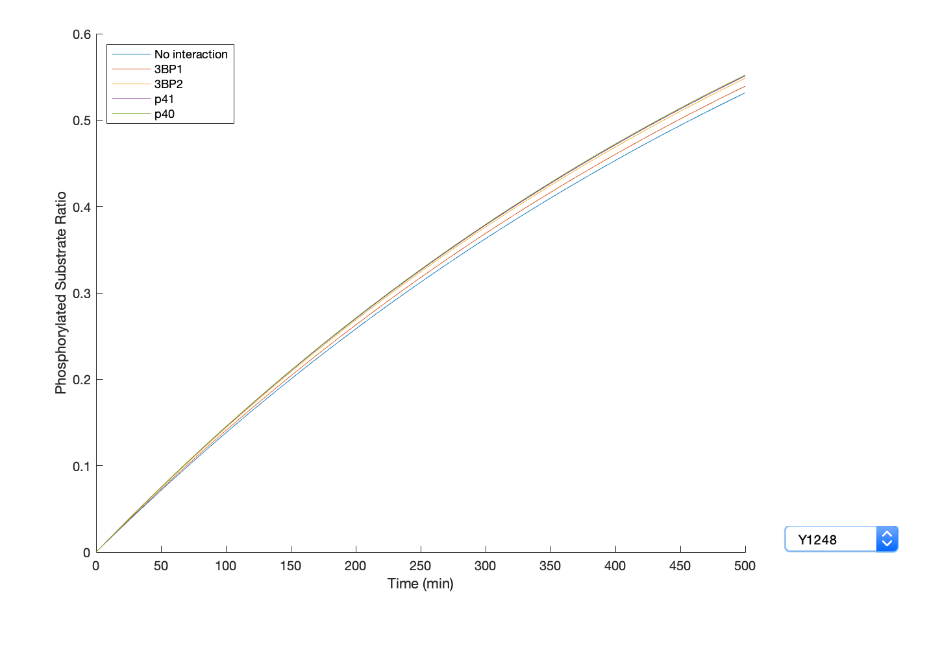
ErbB2 site: Y1248
K_{m} = 197 uM
k_{cat} = 1.6 min⁻¹
k_{cat}/K_{m} = 8.1 min⁻¹mM⁻¹

Slide 18
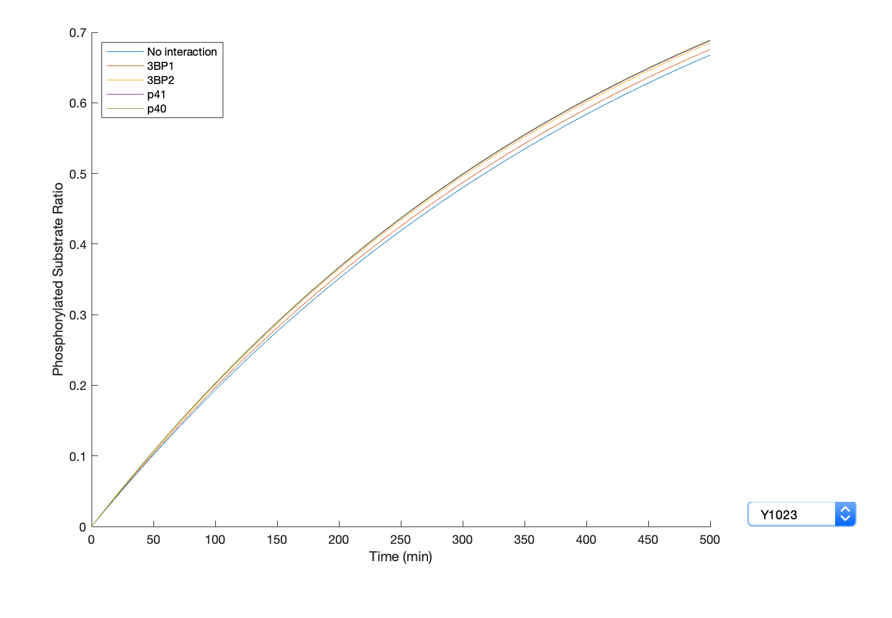
ErbB2 site: Y1023
K_{m} = 215 uM
k_{cat} = 2.5 min⁻¹
k_{cat}/K_{m} = 11.7 min⁻¹mM⁻¹

Slide 19
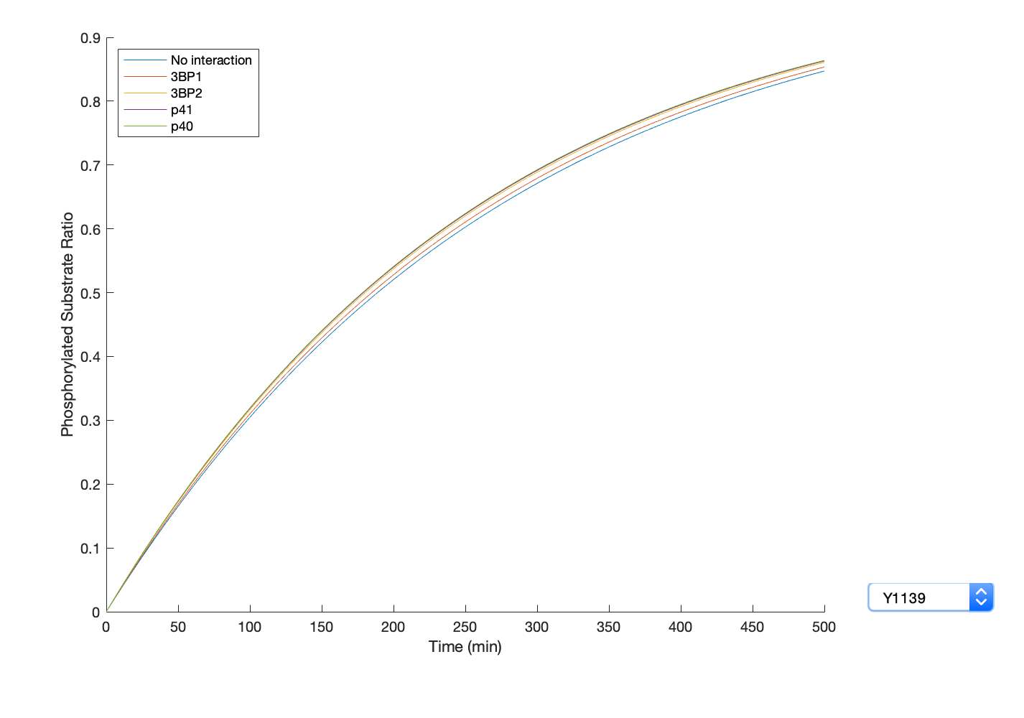
ErbB2 site: Y1139
K_{m} = 220 uM
k_{cat} = 4.3 min⁻¹
k_{cat}/K_{m} = 19.5 min⁻¹mM⁻¹

Slide 20
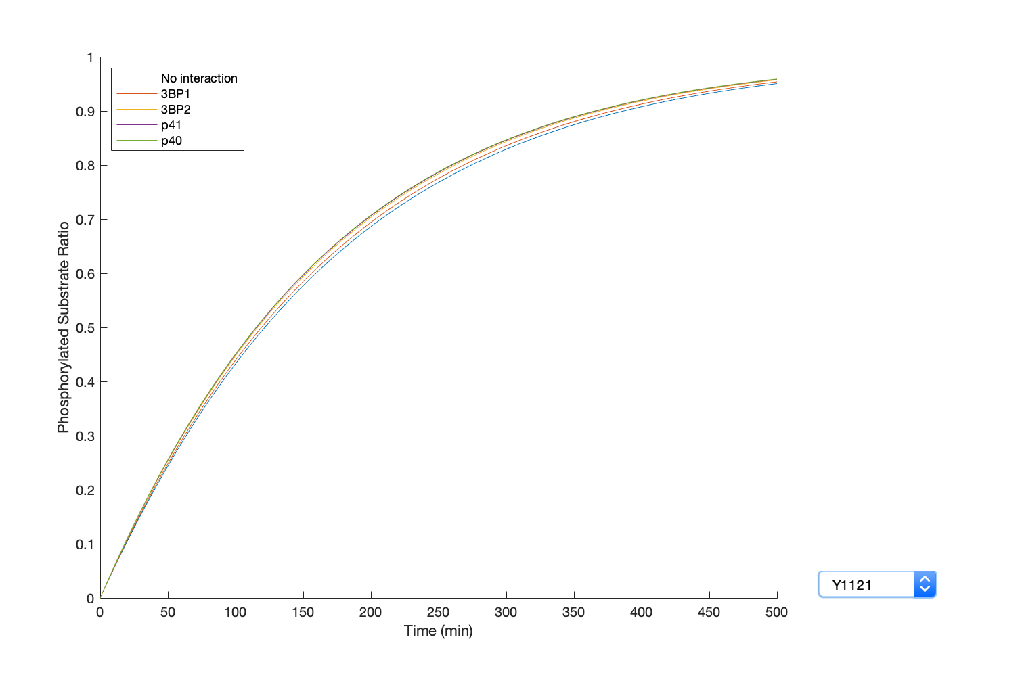
ErbB2 site: Y1121/1122
K_{m} = 140 uM
k_{cat} = 4.4 min⁻¹
k_{cat}/K_{m} = 31.8 min⁻¹mM⁻¹

Slide 21
Future/Ongoing Work
Finding kinase specificities for EGFR C-tail sites
Encoding for the effective linker length
Going through code sent by Casim
Using the info we have about the linkers for the kinase and substrate vectors

